Slide 1

P peline
The Data
Announcements
© Jennifer Mankoff
The Data Pipeline; HCII; Spring 2014

Slide 2
TAs
We have a new set up with TAs
Jeel Jasani
Xiangyu

Slide 3
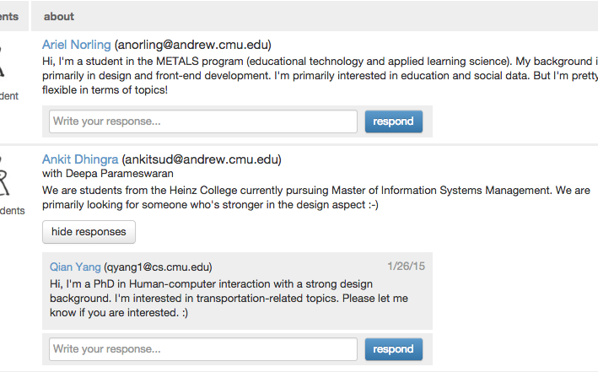
Use Piazza to form teams…

